Slide 1
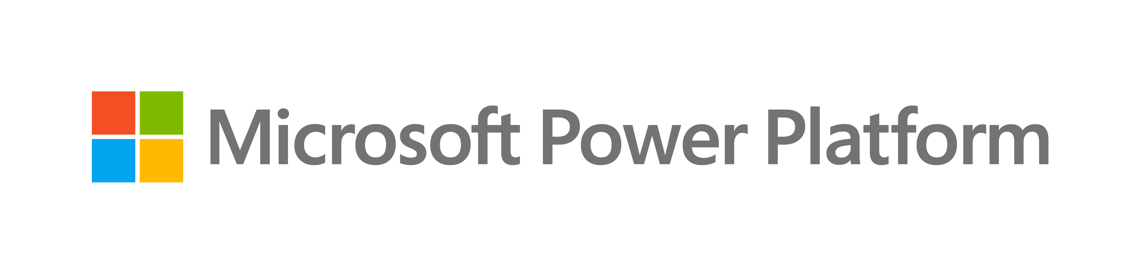
The power of the platform
Notes:
Good morning, everyone and thank you for joining me today!

Slide 2

Empower everyone who needs to create business software.
Notes:
Microsoft’s mission is “Empower every person and organization in the planet to achieve more”.
Our mission in Power Platform is to empower everyone who needs to create business software by giving them the best toolset in the planet.
In other words, if you have a business problem that can be solved with software, we want to provide you the best tools in the world to solve it, no matter what the problem is.
Now, empower means something very specific in the Power Platform: Our rich tools, which are many, best in class in the industry, and we are very proud of, take the backseat..…and your business needs, context and constraints take the front seat.
The tools are at the service of your needs and can accommodate any context and constraints, so you can use them in your terms. Your business goals come first, and our products are just tools to help you achieve those goals efficiently!

Slide 3
No
Code
Low
Code
External
Your solutions,
your way
Vibe
Code
Internal
Now, augmented.
Pro
Code
Copilot
Spec-driven
Notes:
When it comes to how, there are many ways to build a applications: you can go no-code, low code, vibe-code, pro-code, or whatever is the next market trend that will come up in the next few months. We will have it! For example, these days spec-driven development is very popular and we support it. In all cases, we will always support all ways to build your enterprise grade apps with high quality. And, very importantly, you don’t have to pick only one way: you can chose and move between these based on the needs and context of your project.
When it comes to what, you can build web apps, desktop apps, mobile apps, kiosks, web sites. As the market evolve, we evolve with it to. For example, we support composable and decomposable apps that can be part of an agent conversation. And also, you don’t have to pick only one path: again, you can move freely based on the needs of your project.
Finally, when it comes to Where to deploy, you can deploy insider or outside your firewall and now into Copilot too.
And, as the market keeps evolving, the how, what and where evolves with it, so you can always get the best toolset to build enterprise solutions.
We fundamentally believe that these are your solutions, so you can create them your own ways, based on your needs and constraints.
And now, all of this is augmented with Al and agents!

Slide 4

Managed
security
Advanced
protection for an
AI-driven world
Managed
governance
More visibility, more control, less effort
Managed operations
Operational
excellence for
agents at scale
Managed availability
Enterprise-grade reliability for mission critical workloads
All deployed on an enterprise ready platform.
Notes:
Although we talk about choice, when working with Power Platform there is always one constant: all solutions are deployed in an enterprise ready platform that includes managed security, managed governance, managed operations, and managed availability.
So, no matter how you build, what do you build, or where you deploy, you will do it in a secure and enterprise ready platform that can accommodate to your needs, because the Power Platform is about you!

Slide 5
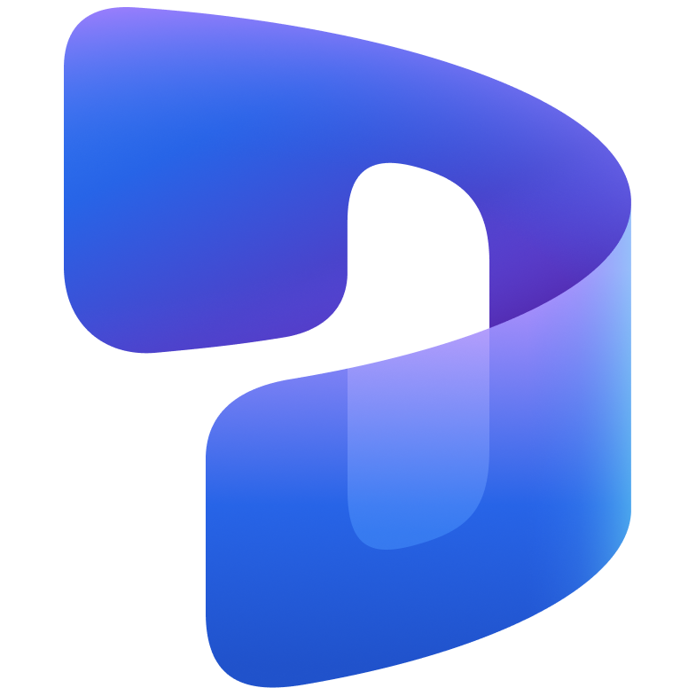

The tools
take the backseat.
Your business takes the front seat.

Slide 6
Power Series Labs
Automation Foundations

Slide 7


The Power Series
One Catalog. Five Tracks. Endless Possibilities.
Let your business need shape the solution.
The Power Series gets you hands-on with every Power Platform capability, so you design the right solution for any business process – one or more apps, automations and agents, working together on a governed foundation. Run a track end to end, or pick the modules that fit your scenario, audience and skill level.
Digitize Internal Operations
Replace manual work with focused apps and connected data
Automate workflows and processes
Reduce repetitive work with automation, approvals, and AI
Improve customer interactions
Create secure experiences for customers, partners and communities
Modernize existing applications
Evolve legacy solutions with modern apps, automation, and AI
Strengthen governance and security
Apply guardrails, visibility, and control across the platform

Slide 8
The Power Series
Lab: Automation Foundations
Create an automated cloud flow triggered by Dataverse events.
Build a conditional, multi-tier approval process that respects approval outcomes.

Slide 9

The Modern Automation Spectrum
From structured, deterministic workflows to adaptive, agentic automations
Rule-Based
Automation
AI-Enhanced
Automation
Agentic
Automation
Autonomous
Agentic Automation
Automations that follow rigid, predetermined rules, executing actions based on predefined triggers.
Step-by-step automations infused with AI-powered actions to handle more complex scenarios and make basic decisions.
Automations that combine AI models with natural language understanding to plan, reason, adapt, and orchestrate workflows
Agents autonomously interpret goals, plan tasks, and learn from experience, with a varying level of human oversight
Structured ----------------------------------------------------------------------------- Adaptive
Power Automate
Copilot Studio
Notes:
“This slide illustrates the evolution of automation capabilities as we move toward agentic automation. It’s a spectrum—from simple rule-based automation to mature autonomous agents.”
1. Rule-Based Automation
“At the starting point, we have rule-based automation. These are simple automations that execute predefined tasks based on fixed rules. They’re highly structured and require significant human oversight.”
“Think of traditional RPA bots that follow a script without any flexibility.”
2. Intelligent Process Automations
“Next, we introduce intelligence into automation. Here, AI combines with automation to add cognitive abilities like natural language processing and machine learning.”
“These systems can handle more complex tasks but still rely heavily on human supervision.”
3. Agentic Workflows
“This is where agentic principles start to appear. Agents can generate content, plan, reason, and adapt within defined domains.”
“However, human validation is still required at critical points to ensure accuracy and compliance.”
4. Autonomous Agents
“Moving further, agents become more independent. They operate autonomously within their domain expertise, adapt strategies, and learn with minimal human intervention.”
“This is a big step toward reducing manual oversight.”
5. Mature Autonomous Agents
“Finally, we reach mature autonomous agents. These AI systems can handle tasks across domains, learn continuously, and self-adapt without human involvement.”
“This represents the ultimate goal of agentic automation—true autonomy and adaptability.”

Slide 10
Rule-Based Automation
Rule-based automations are:
Structured – they operate on predefined logic, steps, and conditions
Deterministic – the same inputs always produce the same outputs
Predictable – they deliver uniform results that are simple to review and troubleshoot
Rule-based automations have been
the standard approach for years

Slide 11
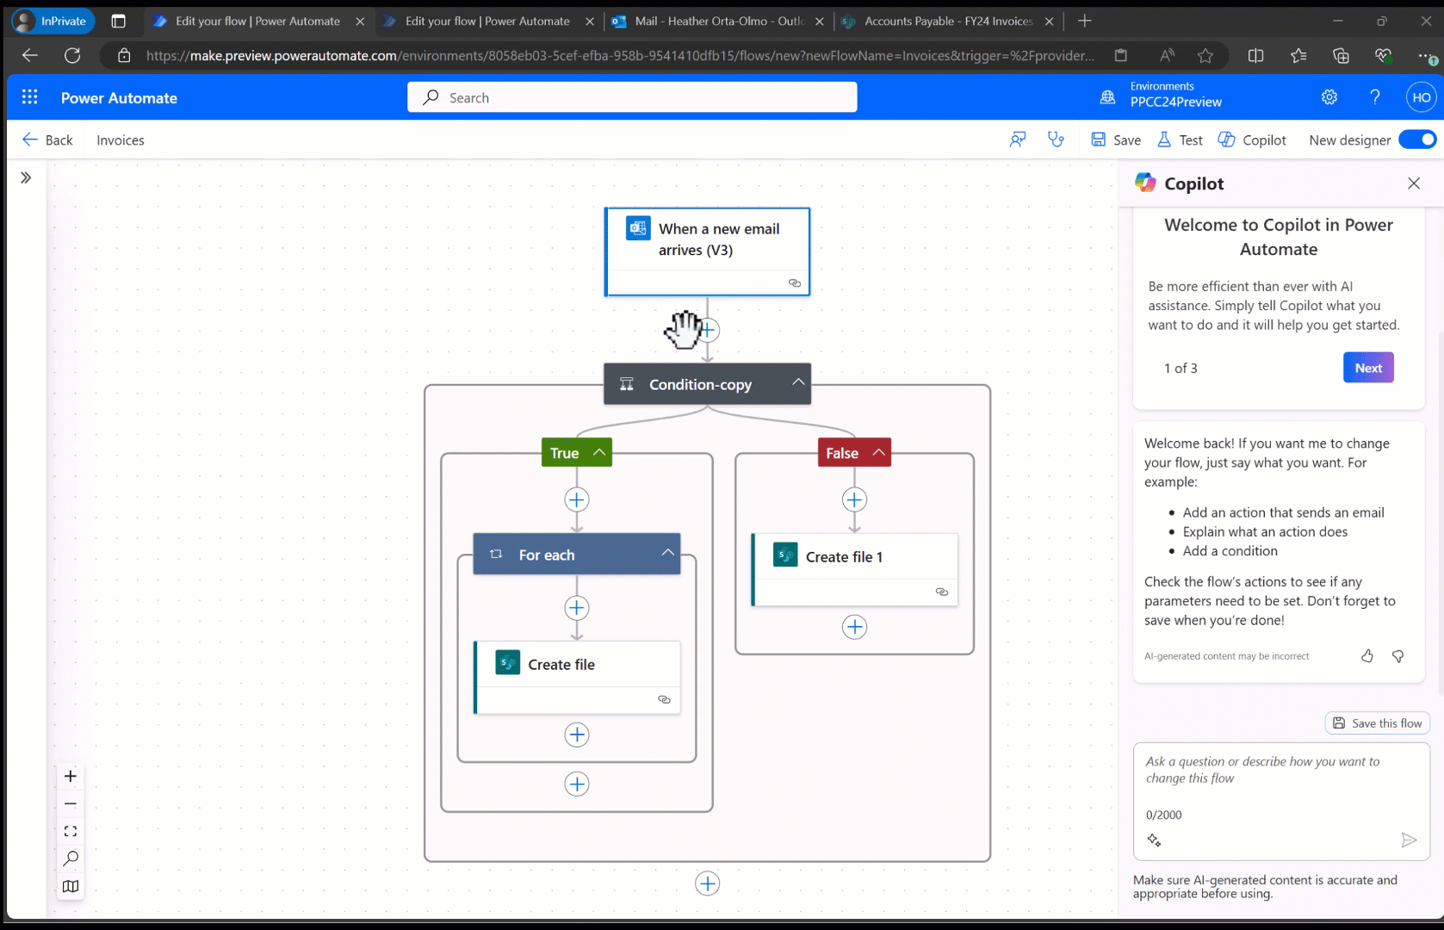
Power Automate Digital Process Automation (DPA)
“Cloud Flows”
Create structured, API-based automations that connect to your applications and automate tasks and processes
Create cloud flows using a flow designer or natural language
Leverage the library of templates for quick automation creation
Add a workflow trigger and actions to create your step-by-step process
Connect to your business applications with our 1,400+ API connector library

Slide 12
AI-Enhanced Automation
AI-enhanced automations are:
Structured, but augmented – the structure and rules still exist; AI performs a task within it
Assistive – use AI within a step to extract, classify, or interpret information for downstream steps
Perceptive – can handle unstructured content such as documents, email text, and sentiment
AI-enhanced automations bring intelligence into the step-by-step workflows we already trust

Slide 13
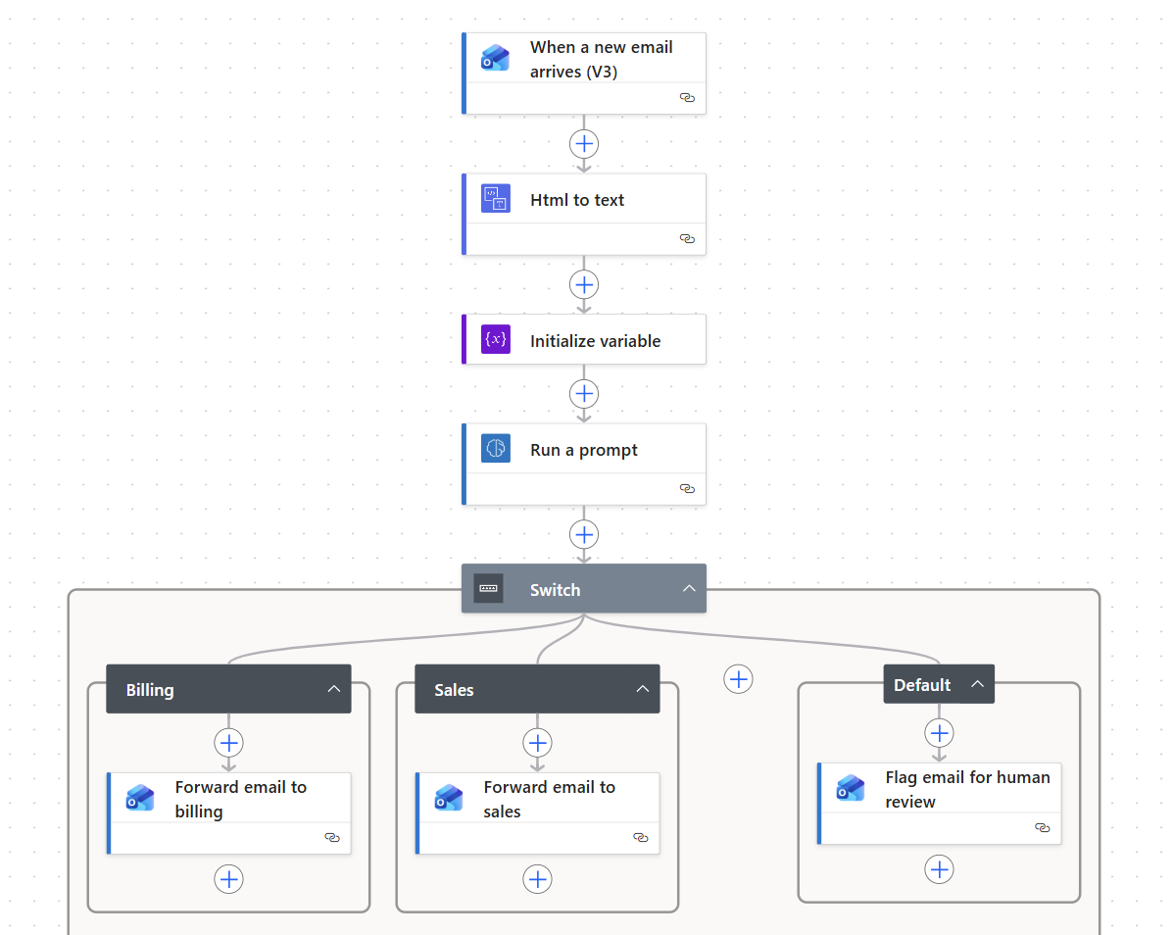
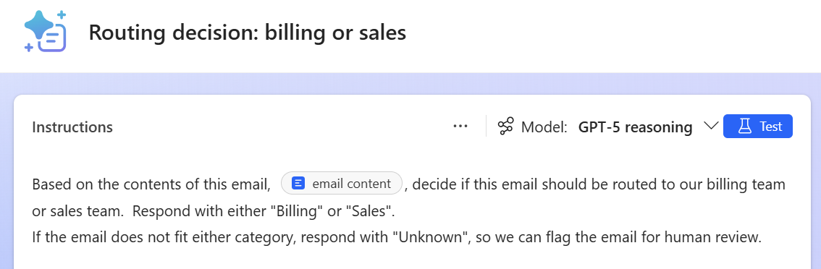
Enhancing Rule-Based Workflows with AI
Updated: Customer service email routing automation
By adding an AI-powered step to this workflow, we provide more adaptability
to the process
AI model uses natural language understanding to capture intent, rather than relying on keywords
Outcome: more flexibility, higher success of proper routing

Slide 14
Intelligent document processing
End-to-end document automation leveraging Power Platform native capabilities
↑
DPA
AI
BPM
RPA
↓
↑
↑
Sales team receive an email in Outlook from a client containing a Request For Proposal with multiple documents.
Key details are stored in Dataverse along with AI confidence data
Validation Power App allows humans to validate form extraction results and fix any errors
RPA bot receives inputs from cloud flow and inserts data into legacy portal/application.
↑
DPA
DPA+AI
AI
↓
↑
Power Automate responds to email receipt trigger and processes attachments
Documents are analyzed using AI tools in Copilot Studio and key details are extracted
Upon validation, Power Automate triggers a desktop flow
Notes:
And document processing is easier than ever before with comprehensive automation capabilities including AI. This is what that looks like for a proposal process.
We use DPA, or digital process automaton, to receive an RFP sent to the sales team in Outlook. Power Automate responds to this event by kicking of a workflow that analyzes the document with AI builder using a prebuilt forms processing model to extract details from the RFP.
After storing key details in Dataverse, the data is sent to a designated person to review and validate the information. Finally, the data needs to be stored in a legacy system that doesn’t have API integrations. So instead of using digital process automation, we use robotic process automation to emulate the actions of a person. An RPA bot then copies the necessary information into the legacy system of record to complete the flow.

